Slide 1
Object-Oriented Analysis and Design
Chapter 17, 25: GRASP Patterns

Slide 2
What will we learn?
GRASP – More patterns

Slide 3
GRASP Patterns
Recall that these are general principles for software design
Patterns of design that have been successfully applied
We have explored 3:
Creator (who creates a new instance)
Expert (general principle for assigning responsibilities to objects)
Low Coupling (how best to support low dependency, low change impact, high reuse)
Now we will explore the remaining six patterns

Slide 4
GRASP Patterns: Controller
Problem: What first object beyond the User Interface layer receives and coordinates (“controls”) a system operation?
Solution: Assign responsibility to a class representing one of the following choices:
Represents the overall “system”, a “root object”, a device that the software is running in, or a major subsystem (these are façade controllers)
Represents a use case scenario within which the system event occurs, often called a “Handler”, “Coordinator”, or “Session”. Use the same controller class for all system events in the same use case scenario. Note a “session” is a conversation between the system and an actor, and is often organized in terms of use cases
System operations are operations that are performed as the result of a major system (input) event, like hitting “Submit” on a form or pressing the “End Sale” button in the POS
A Controller is the first object (beyond any User Interface object) that is responsible for receiving or handling the event and generating the operation

Slide 5
GRASP Patterns: Controller Example
During Analysis, could have a conceptual class called “System” that owns system operations – but this may not directly translate to a similar class in design …

Slide 7
GRASP Patterns: Controller
For the POS example, we could assign the operations of enterItem and endsale to the Register object, or we could create a POSSystem object, or create ProcessSaleHandler, ProcessSaleSession classes and assign the task of handling the system operations to them
The Controller is a delegation principle; since we don’t want the objects in the UI layer to do application logic, the Controller principle helps to summarize the choices the developer has to decide which Domain object will receive the work requests
Choosing a handler for system events
May have different controller classes for different use cases
Make sure the controller you specify delegates the work, and does not do it itself. It coordinates work, controls activity

Slide 8
GRASP Patterns: Controller
Façade controllers (one class to represent all system operations) are useful when there are not too many system events, or if the UI classes cannot redirect system event messages to specific controllers (message-processing).
Individual use case controllers are good if the façade controller is becoming “bloated” with responsibilities, implying high coupling
Controllers are often seen in web UI, but the principle of Model-View Separation does still apply
This is the Model-View-Controller
Note that even if you decide that individual handlers will be responsible for particular use cases, you still need an overall “main” function to initialize everything
Book shows an example of Java code where the Register handles the enterItem system operation; the Register and client UI still need to be instantiated by something

Slide 9
GRASP Patterns: Bloated Controller
A controller is “bloated” if it is doing too much: A single controller receiving too many system events, the controller itself is performing the logic to process the system event (acting like an Expert), the controller has many attributes and maintains significant amounts of information
Think of the controller as being the “team manager” – delegates work to the experts
Again, the UI layer does not handle system events! It delegates responsibility for handling events to the Application or Domain Layer, where a controller takes over (and probably delegates the work to other Domain Objects)
Not a good idea to have the UI object directly delegate the work to the Domain Object – this would lead to business logic being used in the UI Layer. See following slides.

Slide 12
GRASP Patterns: High Cohesion
Problem: How to keep objects focused, understandable, and manageable, and as a result support Low Coupling?
Solution: Assign a responsibility so that cohesion remains high. In other words, only assign strongly related responsibilities to an object. An element with highly related responsibilities that does not do a tremendous amount of work has high cohesion.
Low cohesion classes:
Complicated, hard to understand
Hard to reuse
Hard to maintain
Brittle; easily affected by change

Slide 13
High Cohesion: POS Example
The POS system needs to handle a makePayment system event; if we are using the Register as the controller, it may make sense to have the Register create the Payment object and then send an addPayment() message to the Sale object, and include the new Payment object as a parameter.

Slide 14
High Cohesion: POS Example
Note this is OK for this simple scenario, but using this approach we may end up adding more and more responsibilities to the Register.
We may have selected the Register object as our controller (since in the real world domain the register is probably the device the software is running on), but remember controllers should delegate
Adding too much functionality to the Register object can lead to low cohesion – a complicated object that does too many different things
Better approach may be to have the Register pass the makePayment() message to the Sale, and have the Sale object instantiate the Payment (next slide)

Slide 16
High Cohesion: Observations
High cohesion objects are useful when dealing with relational databases – design separate classes to deal with different parts of the RDB
In general, high cohesion classes usually have few methods with highly related functionality
Collaborate with other objects to accomplish tasks
Analogy: Avoid “overloading” one member of your team with too many responsibilities – distribute the workload among experts, don’t assign them unrelated activities
This is similar to “modular design”
High cohesion is related to low coupling – bad cohesion leads to bad coupling, and viceversa

Slide 17
Polymorphism
Problem: How to handle alternatives based on type? How to create pluggable software components?
Solution: When related alternatives or behaviors vary by type (or class), assign responsibilities for the behavior (using polymorphic operations) to the types for which the behavior varies.
Polymorphism: Here it means “giving the same name to services in different objects” when services are similar or related. So for example, the different objects may implement a common interface or be members of the same super-class.
Example: Consider the NextGen POS system. Suppose we are designing the system, and we are assigning the responsibility for a getTaxes() system operation. The system needs to support various different tax calculators. They may each have a different interface – how to do this efficiently?

Slide 18
Polymorphism: NextGen Example
This is a good candidate for polymorphism – we have many different objects (the tax calculators) that each do the same work, but in related (different) ways
The solution would be to create an interface that defines a getTaxes() method, and then define adaptor classes for each calculator that support the interface and implement the getTaxes() method in a way that is consistent with that calculator
Notice we have used the Polymorphism principle to assign the responsibility of handling the getTaxes() system operation to the entities for which the behavior varies.
In other words, rather than try to harmonize all of the different calculators in our system, we simply created adaptor classes and let each adaptor class handle the responsibility.
Much more maintainable, flexible, robust – can plug in new calculators, remove calculators, etc. without changing the base system

Slide 20
Polymorphism: Monopoly Example
In Monopoly, there are different kinds of squares that require different behavior when landed on:
Go square – player receives $200
Income Tax square – player must pay tax amount
Go to Jail square – player goes to the Jail
Regular square – nothing new happens right now, in more detailed use case player can buy or pay rent
When designing the simulation application system, we must decide how to assign the responsibility of handling the system operation that occurs when a Player rolls the dice and lands on a square
Note that although the Player always lands on a square, there are different behaviors depending upon Square type
Avoid doing this as a “Switch” statement in the system – too rigid. Use Polymorphism.

Slide 21
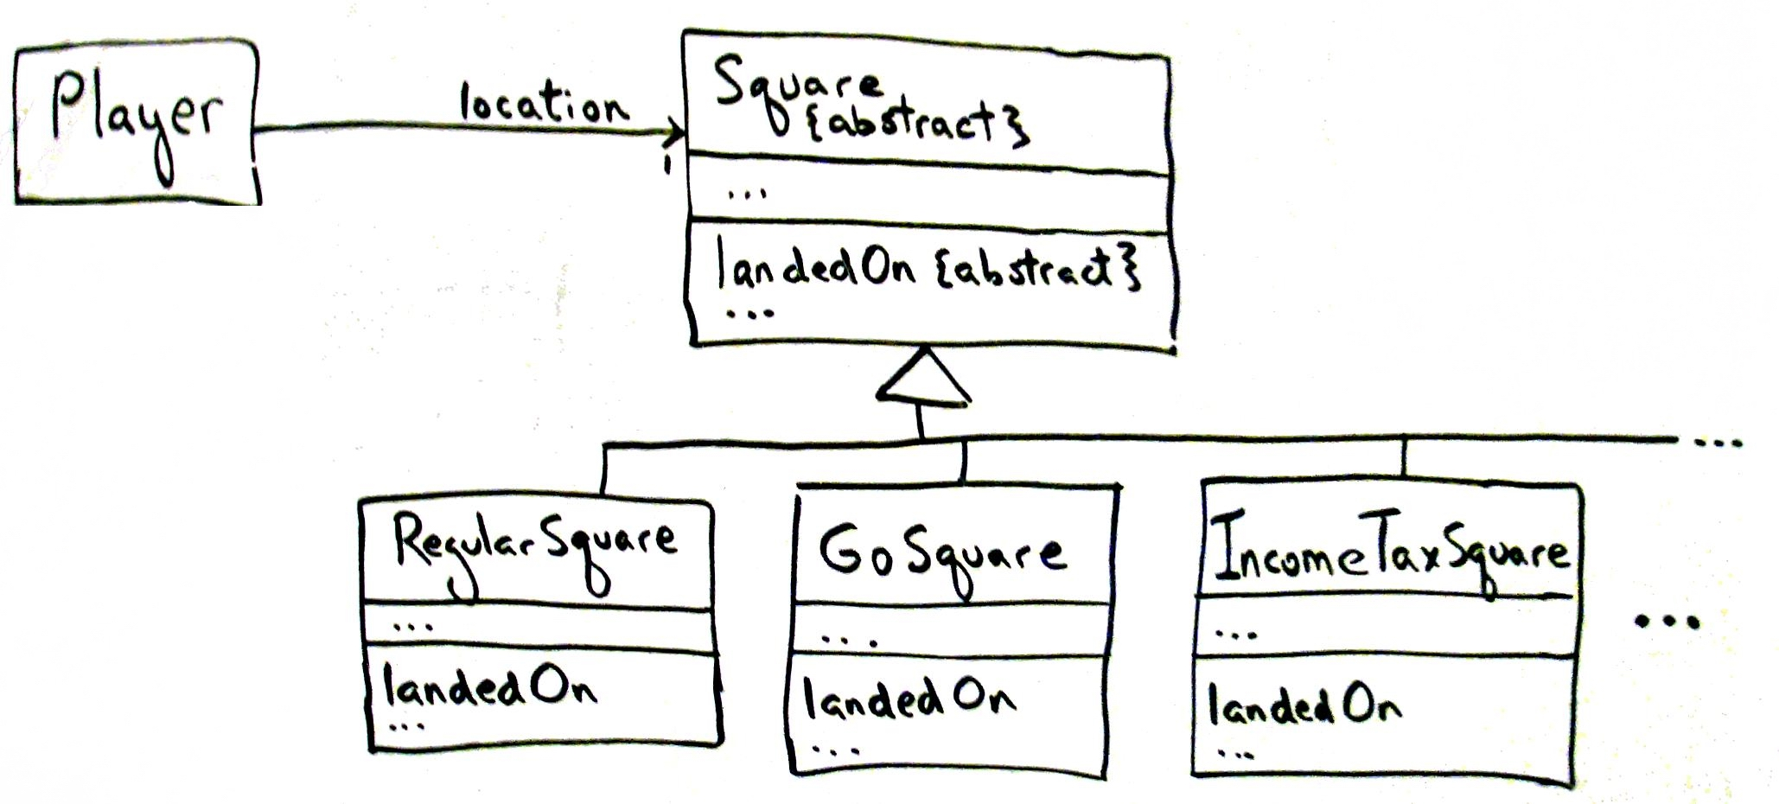

Slide 22
Polymorphism: Monopoly Example
Here we have defined an abstract Square class with an abstract method called landedOn(). We can then define subclasses for the types of Squares, and each can (using Polymorphism) define their own behaviors for the landedOn() method.
Note the Player only needs to be aware of the landedOn() method name
The Player knows the current location (Square) he/she is on, and the Player rolls the dice and gets the value
The Player can then check with the Board to get the next square, and then use the landedOn() method to initiate the behavior associated with that square.
This is better than having the Player maintain a list of behaviors for each type of square and then having the Player implement the behavior
See next slide for examples

Slide 23
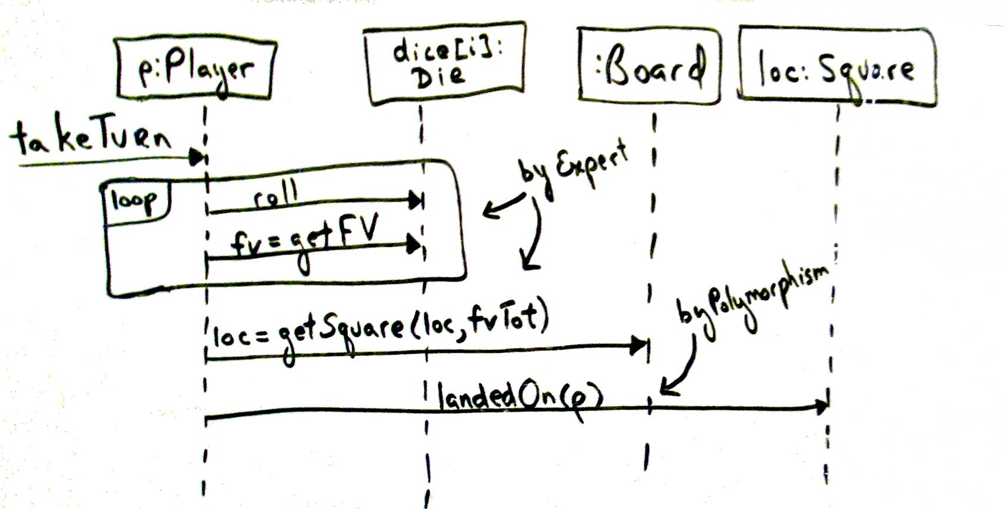

Slide 24
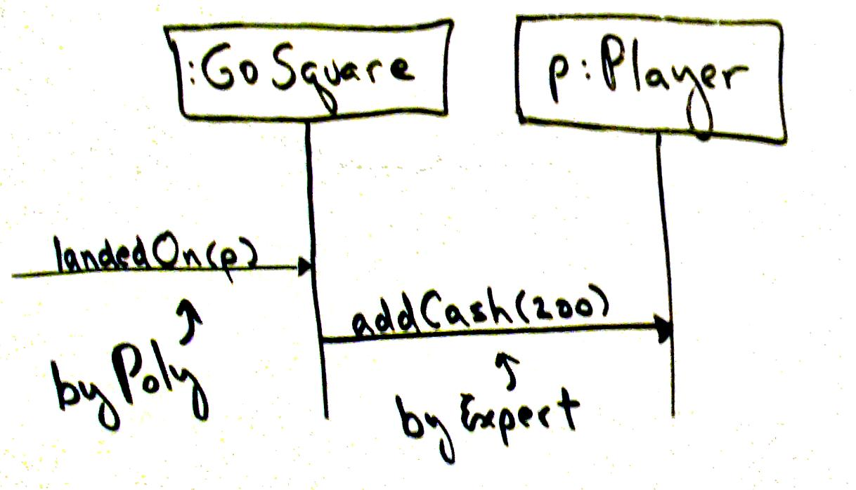
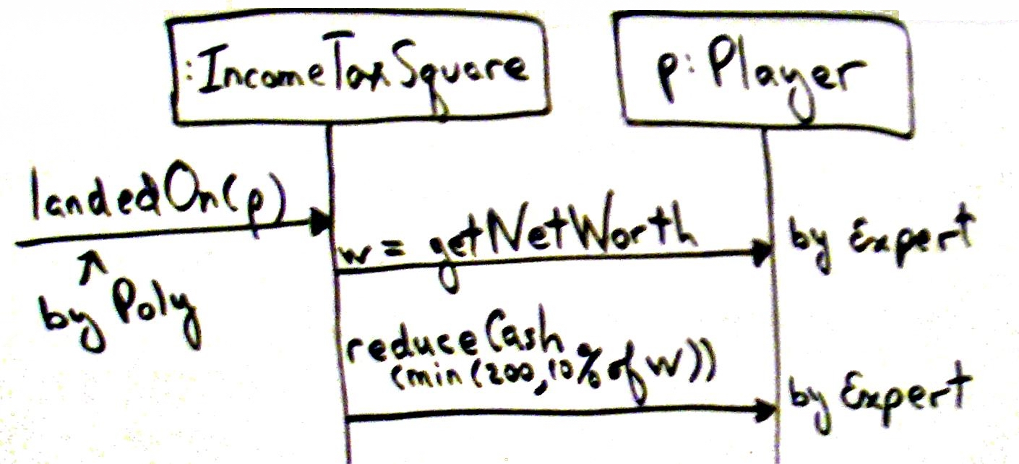

Slide 25
Polymorphism: Observations
Polymorphism is fundamental when designing a system for which a system operation may generate multiple variations of behavior (landedOn(), getTaxes())
Usually, this will result in the definition of interfaces or abstract classes
Use interfaces to support polymorphism without creating a new class hierarchy
In general, creating interfaces is more flexible, since you do not need to be a sub-class of the super-class to implement the interface

Slide 26
Pure Fabrication
Problem: If you do not want to violate High Cohesion and Low Coupling, what object should be assigned responsibility if the solutions offered by the Expert principle are not valid?
Solution: Assign a highly cohesive set of responsibilities to an artificial or convenience class that does not represent a domain conceptual class – i.e., create a new object that does not correspond to a domain object, but has high cohesion, low coupling, and is reusable.
This allows us to make up new classes that are not implied by (or directly associated with) the Domain Model
Often useful to collect responsibilities which simply cannot be assigned to existing objects in a good (high cohesion, low coupling) way

Slide 27
Pure Fabrication: NextGen POS Example
Suppose that in the NextGen system there is a system operation that requires instances of Sale to be saved to a relational database for logging.
Using the Expert principle, we could include the responsibility of handling this operation in the Sale object, but that would require adding a (possibly complicated) set of database interaction code into the Sale object
Sale class becomes less cohesive – DB activity not really related to the purpose of the class
Couples the Sale class to the DB interface
We may want to save instances of other classes into the DB, not just Sale. We need to generalize this action
Better solution is to create a new class that is solely responsible for saving instances of objects into the database
Note this design has better cohesion, coupling, reuse potential

Slide 28
Pure Fabrication: Monopoly Example
Currently, the Player rolls the dice (once for each die), gets the face value as a result of each roll, and computes the total
Somewhat complicates the Player object, and the Dice object is not very reusable
Can use Pure Fabrication to create a new class, Cup
The Cup will be associated with the Dice object, and the Player will request that the Cup roll the dice and return the total
The class Cup can be designed so that on instantiation the total number of die is set
This class may then be used by other game systems, as is.
See the next slide for Design Model diagrams

Slide 29
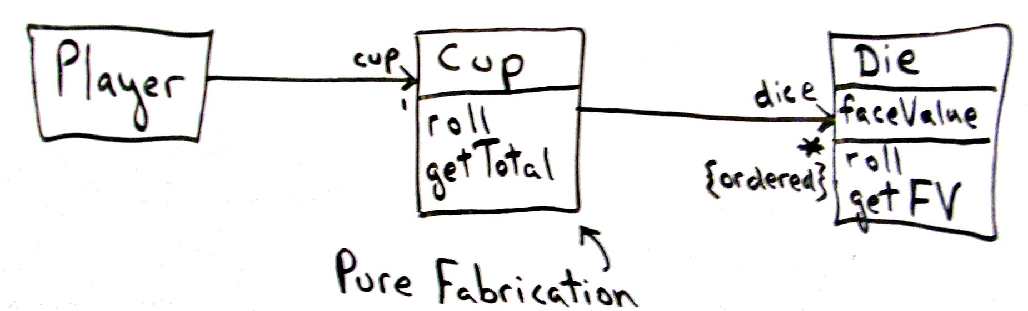
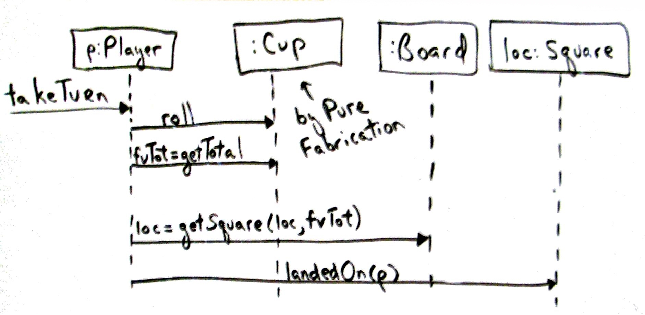

Slide 30
Indirection
Problem: Where to assign a responsibility to avoid a direct coupling between two (or more) things? How to de-couple objects so that low coupling is supported and reuse potential remains high?
Solution: Assign the responsibility to an intermediate object to mediate between other components or services so that they are not directly coupled.
This is very related to Polymorphism and Pure Fabrication
Essentially, create a “go between” or mediator class to insulate (protect) the “inner” design from external elements which may change
The same database example we used for Pure Fabrication would also be an example of Indirection (see next slide)

Slide 31
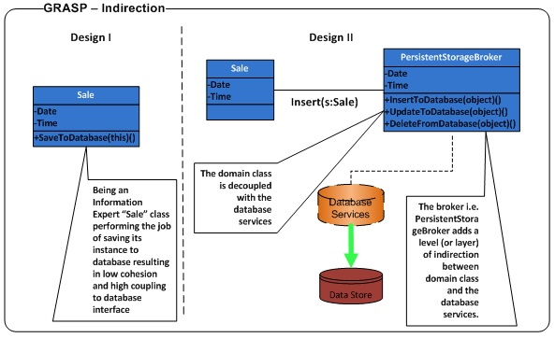

Slide 32
Protected Variations
Problem: How to design objects, subsystems, and systems so that the variations or instability in these elements does not have an undesirable impact on other elements?
Solution: Identify points of predicted variation or instability, assign responsibilities to create a stable interface around them
One example: The “Don’t talk to strangers” principle, which states that an object’s methods should only send messages (i.e. use methods) of objects that it is directly familiar with
Avoid a “chain” of method calls (foo.getA().getB().getC().getD()), because this traverses along the path of object connections to send a message to a distant object.
Dangerous because of the possibility of change along the chain, which could easily break this design (further along you go, more likely something will change and so break)
Related to Indirection, Polymorphism (the Tax Calculator example shows Indirection)

Slide 33
GRASP: Final Thoughts
Note that these are principles of OOD – they are not templates or recipes
Sometimes, the principles contradict each other – as a designer, you need to discover the best approach
Reuse is always a strong motivator, but there are exceptions
There are times when these principles can be ignored or directly violated – see the sections of the text for contradiction examples

Slide 34
Takeaways from Chapter 17, 25
Know the nine GRASP principles, and how to apply them

Slide 35
Next …
We apply GRASP and begin the design of the POS system – read Chapter 18

